Slide 1


Capstone Project - 2
Bike Sharing Demand Prediction
(Supervised Machine Learning regression)
Submitted By
Bhavesh Amol Amre

Slide 2
Problem Statement :
Currently Rental bikes are introduced in many urban cities for the enhancement of mobility comfort. The client is Seoul Bike, which participates in a bike share program in Seoul, South Korea. An accurate prediction of bike count is critical to the success of the Seoul bike share program. It is important to make the rental bike available and accessible to the public at the right time as it lessens the waiting time. Eventually, providing the city with a stable supply of rental bikes becomes a major concern.
The final aim of this project is the prediction of bike count required at each hour for the stable supply of rental bikes.

Slide 3
Work Flow :
So we will divide our work flow into following steps.
Data Collection & Understanding
Data Wrangling & Feature Engineering
EDA
Conclusions
Model Selection and Evaluation
Preparation of data for model building.

Slide 4
Data Collection and Understanding :
We had a Seoul Bike Data for our analysis and model building
The dataset contains weather information (Temperature, Humidity, Wind speed, Visibility, Dew point, Solar radiation, Snowfall, Rainfall), the number of bikes rented per hour and date information.
In this we had total 8760 observations and 14 features including target variable.
Data Description :
Date : year-month-day
Rented Bike count - Count of bikes rented at each hour
Hour - Hour of the day
Temperature-Temperature in Celsius
Humidity - %
Windspeed - m/s
Visibility - m
Dew point temperature - Celsius
Solar radiation - MJ/m2
Rainfall - mm
Snowfall - cm
Seasons - Winter, Spring, Summer, Autumn
Holiday - Holiday/No holiday
Functional Day - NoFunc(Non Functional Hours), Fun(Functional hours)

Slide 5
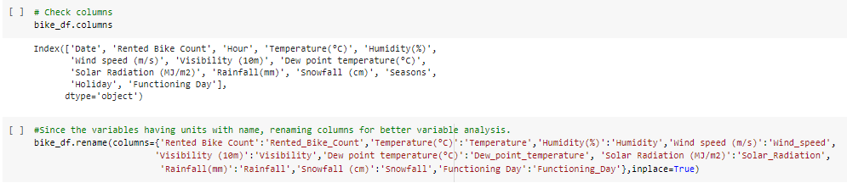
Data Wrangling and Feature Engineering :
As we know we had 8760 observations and 14 features.
Categorical Features: Seasons, Holiday and Functioning day.
Numerical Columns: Date, Hour, Temperature, Humidity, Wind speed, Visibility, Dew point temperature, Solar radiation, Rainfall, Snowfall, Rented Bike count.
Rename Columns: We renamed columns because they had units mentioned in brackets and was difficult to copy the feature name while working.

Slide 6
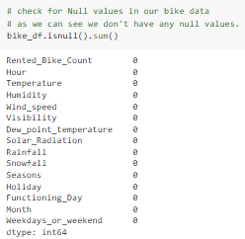

Data Wrangling and Feature Engineering :
We had zero null values in our dataset.
Zero Duplicate entries found.
We changed the data type of Date column from ‘object’ to ‘datetime64[ns]’. This was done for feature engineering.
We Created two new columns with the help of Date column ‘Month’ and ‘Day’. Which were further used for EDA. And later we dropped Date column.

Slide 7

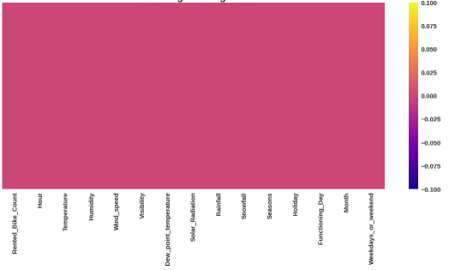
Data Wrangling and Feature Engineering :.

Slide 8
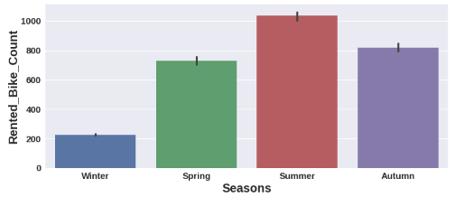
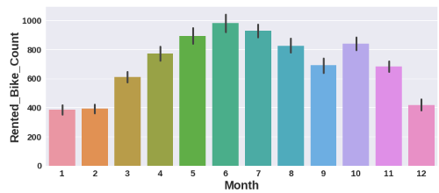
EDA(Exploratory Data Analysis) :
Relation of rented bike count with categorical features:
Summer season had the highest Bike Rent Count. People are more likely to take rented bikes in summer. Bike rentals in winter is very less compared to other seasons.
From March Bike Rent Count started increasing and it was highest in June.It was lowest in January and February.

Slide 9
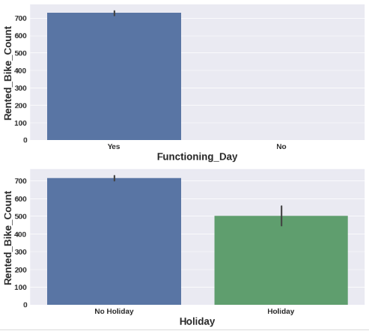
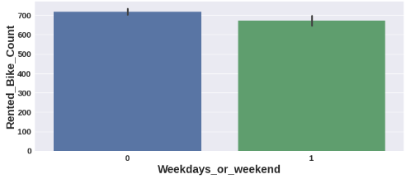
EDA(Exploratory Data Analysis) :
Zero Bikes were rented on no functioning day. More than 700 bikes rented on functioning day.
More than 700 bikes were rented on No Holidays and almost 500 bikes were rented on Holidays
More than 700 bikes were rented on weekdays. On weekends, almost 650 bikes were rented.

Slide 10
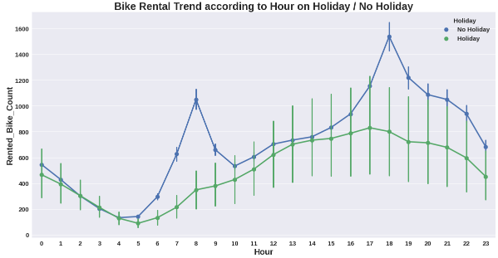
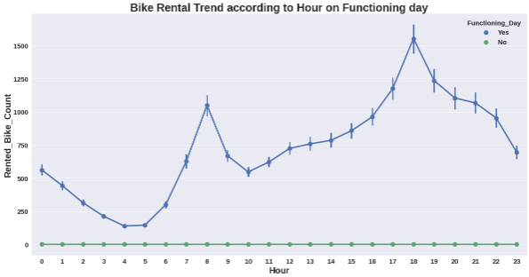
EDA(Exploratory Data Analysis) :
Bike Rent Trend according to hour in different scenarios:
1)Here we observed that, Bike rental trend according to hours is almost similar in all scenarios.
2)There is sudden peak between 6/7AM to 10 AM. Office /College going time could be the reason for this sudden peak on NO Holiday. But on Holiday the case is different,very less bike rentals happened.
3) Again there is peak between 4PM to 7 PM. may be its office leaving time for the above people.( NO Holiday).
4)Here the trend for functioning day is same as of No holiday. Only the difference is on No functioning day there were zero bike rentals.

Slide 11
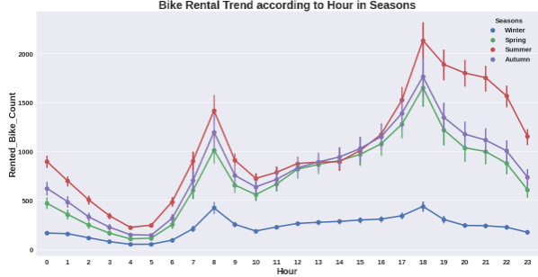
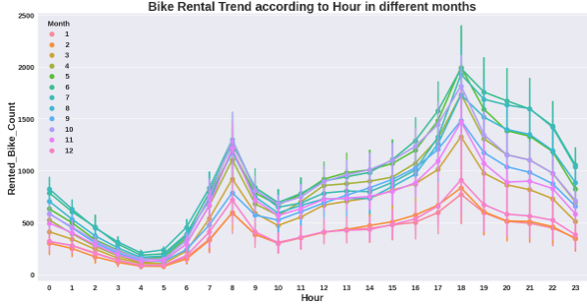
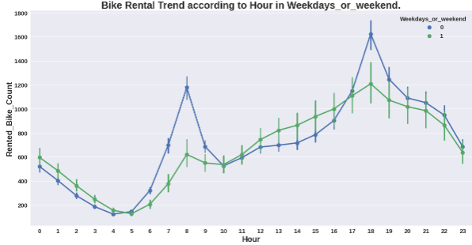
EDA(Exploratory Data Analysis) :

Slide 12
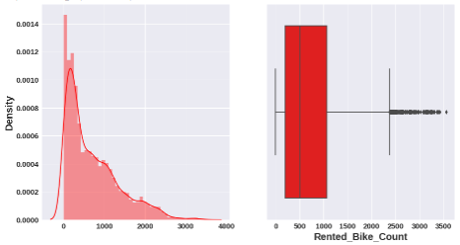
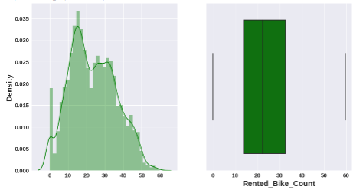
EDA(Exploratory Data Analysis) :
Distribution of target variable- Bike Rent Count
Distribution is rightly skewed and some outliers are To normalize the distribution we applied square root observed. method. After normalization no outliers were found.

Slide 13
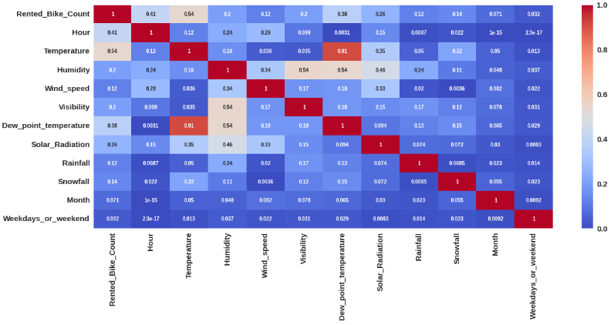

Preparation of data for model building :
With the help of heat map we can see
Temperature and Dew point temperature are
91 % correlated. So we dropped the Dew point temperature because it has very low correlation with our target variable as compared to temperature.
By using variation inflation factor we dropped ‘Visibility’ and ‘Humidity’ features as they had VIF value more than 5.
We have created dummy variables for categorical Seasons column and did mapping with 0 and 1 for holiday and functioning column.
Thus we prepared our data for model building.

Slide 14
Model Selection and Evaluation:
As this is the regression problem we are trying to predict continuous value. For this we used following regression models.
Linear Regression
Lasso regression (regularized regression)
Ridge Regression(regularized regression)
Elastic Net Regression
Decision Tree regression.
Random forest regression
Gradient Boosting regression.
Assumptions of regression line:
1.The relation between the dependent and independent variables should be almost linear.
2.Mean of residuals should be zero or close to 0 as much as possible. It is done to check whether our line is actually the line of “best fit”.
3.There should be homoscedasticity or equal variance in a regression model. This assumption means that the variance around the regression line is the same for all values of the predictor variable (X).
4.There should not be multicollinearity in regression model. Multicollinearity generally occurs when there are high correlations between two or more independent variables.
Before and after applying these models we checked our regression assumptions by distribution of residuals, scatter plot of actual and predicted values, removing multi-colinearity among independent variables.

Slide 15
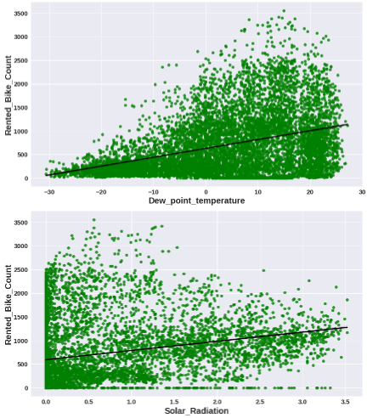
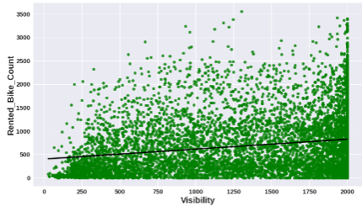
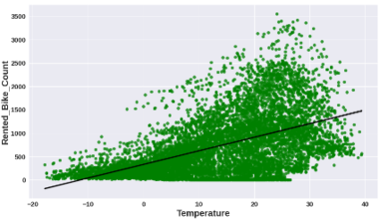
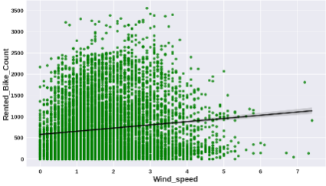
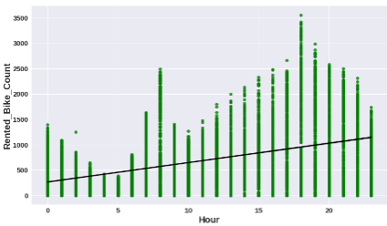
Model Selection and Evaluation:
From the above regression plot of all numerical features we see that the columns 'Temperature', 'Wind_speed', 'Visibility', 'Dew_point_temperature', 'Solar_Radiation' are positively relation to the target variable,which means the rented bike count increases with increase of these features.

Slide 16
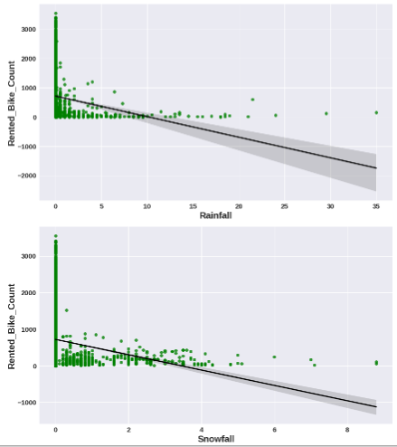
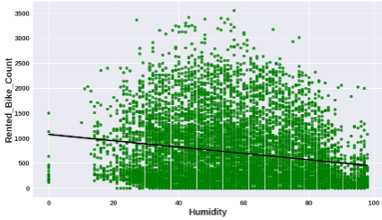
Model Selection and Evaluation:
'Rainfall',‘ Snowfall’, 'Humidity' these features are negatively related with the target variable which means the rented bike count decreases when these features increase.

Slide 17


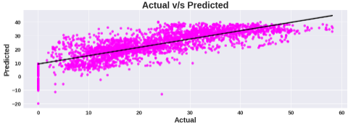
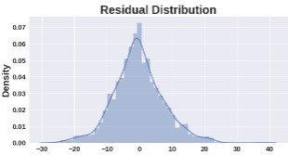

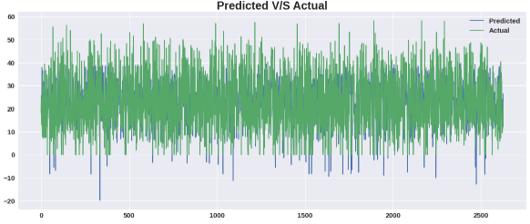
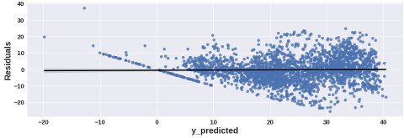
Model Selection and Evaluation:
Linear Regression
Scores on Train Set Scores on Test Set

Slide 18


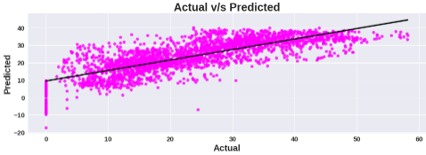
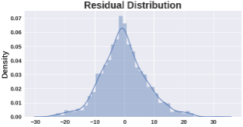
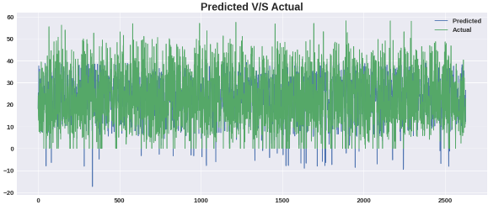
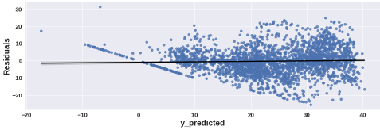
Model Selection and Evaluation:
Lasso (Hyper-parameter tuned- alpha=0.01)
Scores on Train Set Scores on Test Set

Slide 19


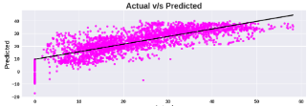
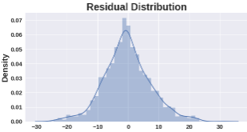
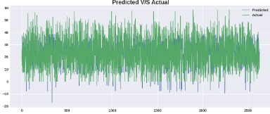
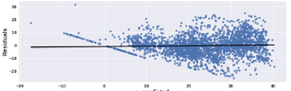
Model Selection and Evaluation:
Ridge (Hyper-parameter tuned- alpha=0.1)
Scores on Train Set Scores on Test Set

Slide 20



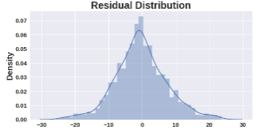
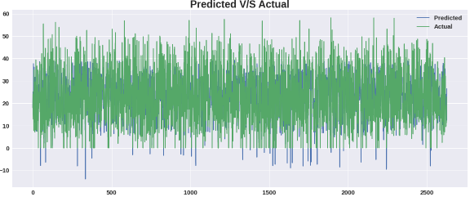
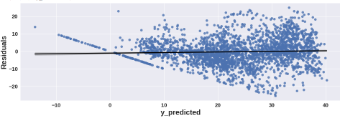
Model Selection and Evaluation:
Elastic Net (Hyper-parameter tuned- alpha=0.001,l1_ratio=0.5)
Scores on Train Set Scores on Test Set

Slide 21


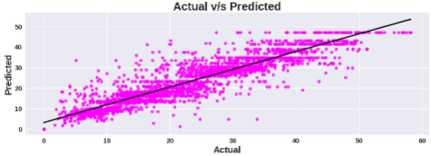
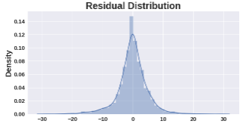
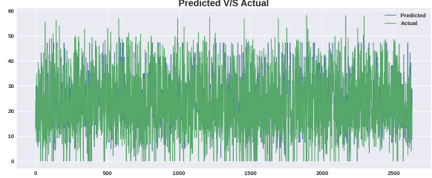
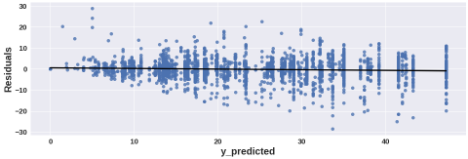
Model Selection and Evaluation:
Decision Tree regression(Hyper-parameter tuned- max_depth=9,max_features='auto')
Scores on Train Set Scores on Test Set

Slide 22


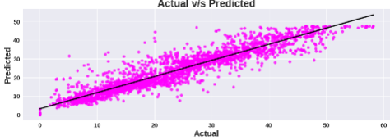
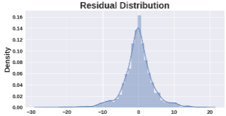
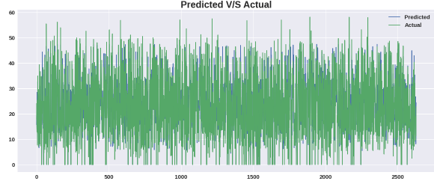
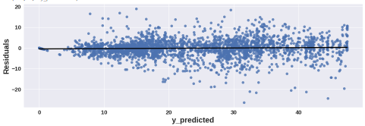
Model Selection and Evaluation:
Random forest regression(Hyper-parameter tuned- 'max_depth': 9, 'n_estimators': 100')
Scores on Train Set Scores on Test Set

Slide 23


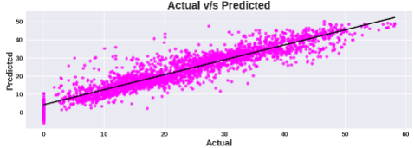
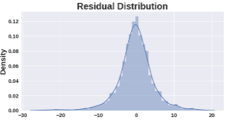
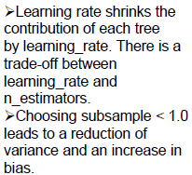
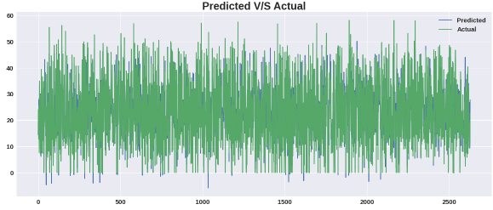
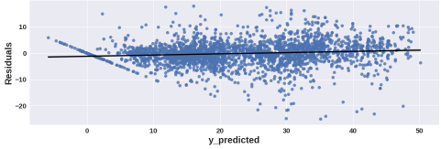
Model Selection and Evaluation:
Gradient boosting regression(Hyper-parameter tuned- 'learning_rate': 0.04, 'max_depth': 8, 'n_estimators': 150, 'subsample': 0.9)
Scores on Train Set Scores on Test Set

Slide 24



Feature Importance's :
From all the 3 models we can see that temperature, hour, functioning day are the top three important features among all the features.

Slide 25

Conclusion :
As we have calculated MAE,MSE,RMSE and R2 score for each model. Based on r2 score will decide our model performance.
Our assumption: if the difference of R2 score between Train data and Test is more than 5 % we will consider it as over fitting.
Linear, Lasso, Ridge and Elastic Net:
Linear, Lasso, Ridge and Elastic regression models have almost similar R2 scores(61%) on both training and test data.(Even after using GridserachCV we have got similar results as of base models).
Decision Tree Regression:
On Decision tree regressor model, without hyper-parameter tuning, we got r2 score as 100% on training data and on test data it was very less. Thus our model memorized the data. So it was a over fitted model. After hyper-parameter tuning we got r2 score as 88% on training data and 83% on test data which is quite good for us.

Slide 26
Conclusion :
Random Forest:
On Random Forest regressor model, without hyper-parameter tuning we got r2 score as 98% on training data and 90% on test data. Thus our model memorized the data. So it was a over fitted model, as per our assumption After hyper-parameter tuning we got r2 score as 90% on training data and 87% on test data which is very good for us.
Gradient Boosting Regression(Gradient Boosting Machine):
On Random Forest regressor model, without hyper-parameter tuning we got r2 score as 86% on training data and 85% on test data. Our model performed well without hyper-parameter tuning. After hyper-parameter tuning we got r2 score as 96% on training data and 91% on test data, thus we improved the model performance by hyper-parameter tuning.
Thus Gradient Boosting Regression(GridSearchCV) and Random forest(GridSearchCv) gives good r2 scores. We can deploy this models.

Slide 27
THANK YOU

